Slide 1
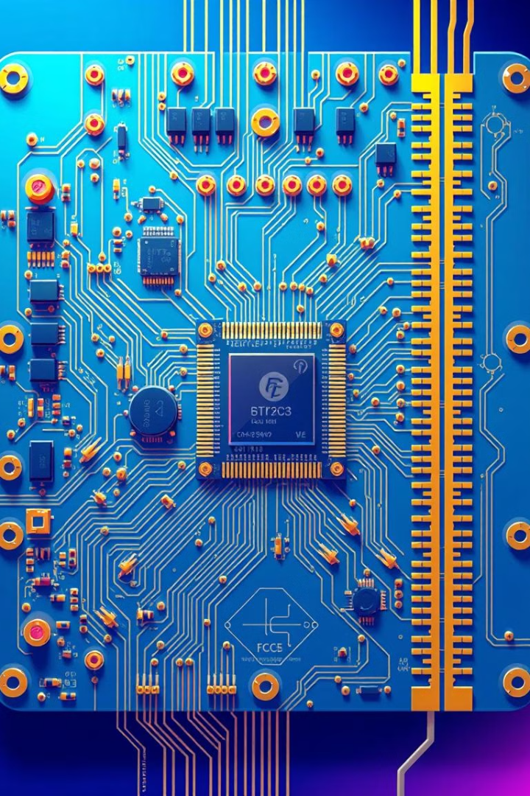
Hardware Implementation of Finite State Machines for Embedded Systems
Embedded systems play a crucial role in our daily lives, powering everything from consumer electronics to industrial automation. At the heart of these systems lie Finite State Machines (FSMs), which provide a powerful and efficient way to control and coordinate complex processes.
TG
by THARUN G

Slide 2

Introduction to Finite State Machines (FSMs)
Discrete States
Event-Driven Logic
FSMs represent a system's behavior as a set of discrete states, with defined transitions between them.
FSMs react to external events, triggering state changes and initiating appropriate actions.
Deterministic Operation
Versatility
FSMs follow a well-defined, predictable sequence of states, ensuring reliable and consistent behavior.
FSMs can be used to model a wide range of applications, from simple control systems to complex decision-making processes.

Slide 3

Advantages of FSM-based Embedded Systems
Efficient Design
Scalability
FSMs offer a structured and modular approach to designing embedded systems, simplifying development and maintenance.
FSMs can be easily scaled to accommodate increasing complexity, making them well-suited for advanced embedded applications.
1
2
3
Reliability
The deterministic nature of FSMs ensures predictable and repeatable behavior, reducing the risk of errors and malfunctions.

Slide 4
FPGA as a Platform for Hardware FSM Implementation
Parallelism
Reconfigurability
Performance
FPGAs' inherent parallel processing capabilities allow for the efficient implementation of multiple, concurrent FSMs.
FPGA designs can be easily modified and updated, enabling flexible and adaptable FSM-based systems.
The hardware-based implementation of FSMs on FPGAs delivers high-speed, real-time performance for demanding embedded applications.

Slide 5

Design Considerations for Hardware FSM Implementation
1
State Encoding
2
Timing Analysis
Efficient encoding of FSM states to optimize resource utilization and performance on the FPGA.
Ensuring that the FSM design meets the required timing constraints for the target application.
3
Power Optimization
4
Testability
Techniques to minimize power consumption, such as clock gating and state-based power management.
Incorporating test strategies to verify the correctness and robustness of the hardware FSM implementation.

Slide 6
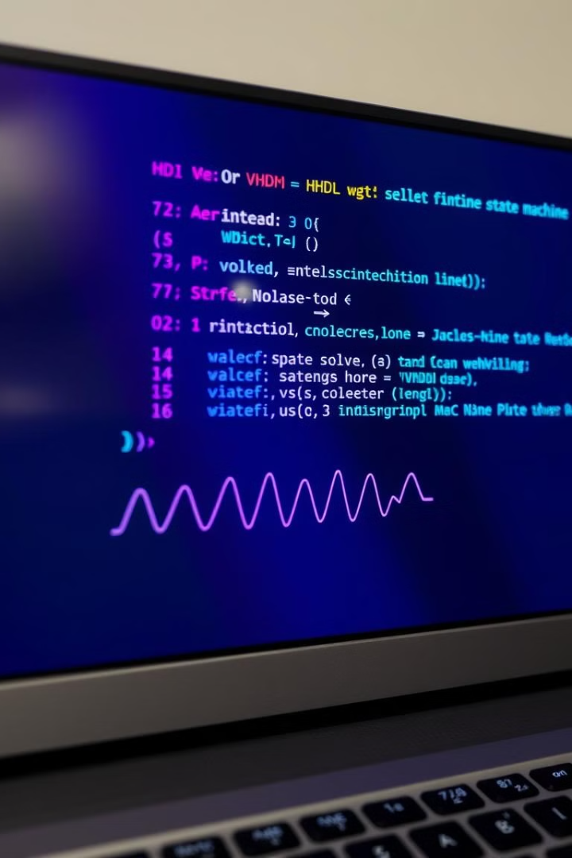




Modeling and Synthesis of FSMs in Hardware Description Languages
VHDL
Verilog
Widely used hardware description language for the design and synthesis of FSMs.
Another popular HDL for implementing and simulating FSM-based hardware designs.
State Diagrams
Synthesis
Graphical representation of FSM behavior, used for design, documentation, and verification.
The process of translating HDL code into a gate-level implementation for the FPGA.

Slide 7





FPGA-based FSM Implementation Techniques
State Encoding
State Registers
Combinational Logic
Pipelining
Using efficient state encoding schemes, such as one-hot or binary, to optimize FPGA resource utilization.
Implementing state registers using FPGA-based flip-flops or LUTs (Look-Up Tables) for state storage.
Designing the combinational logic circuits to define state transitions and output generation.
Employing pipelining techniques to improve the throughput and operating frequency of the FSM.

Slide 8

Applications and Case Studies of Hardware FSM in Embedded Systems
Motor Control
FSMs for precise control of stepper and servo motors in robotics and automation.
Protocol Handling
FSMs for implementing communication protocols in embedded networking and IoT devices.
Signal Processing
FSMs for real-time processing and analysis of sensor data in industrial and medical applications.
Security Enforcement
FSMs for access control, authentication, and encryption in embedded security systems.

Slide 9
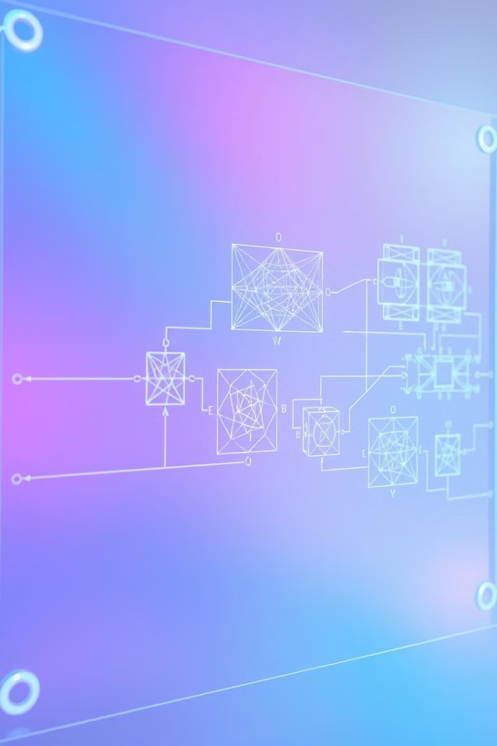
Conclusion and Future Trends
As embedded systems continue to grow in complexity and importance, the use of hardware-based Finite State Machines will remain a crucial design approach. Future trends may include the integration of FSMs with emerging technologies like AI and machine learning, further enhancing the capabilities of embedded systems.

